Slide 1
Credit Risk EDA
Case Study Submission
Hammad Moin Siddiqui
Himanka Das
IIIT, B PGDSc Batch 026
1st Mar, 2021

Slide 2
Objective
To demonstrate application of EDA in a real business scenario in banking and financial services data set to identify patterns which indicate if a client has difficulty paying their installments which may be used for taking actions such as denying the loan, reducing the amount of loan, lending (to risky applicants) at a higher interest rate, etc.
This will ensure that the consumers capable of repaying the loan are not rejected. Identification of such applicants and understand how data is used to minimize the risk of losing money while lending to customers.

Slide 3
Problem statement
When the company receives a loan application, the company has to decide;
If the applicant is likely to repay the loan, then not approving the loan results in a loss of business to the company
If the applicant is not likely to repay the loan, i.e. he/she is likely to default, then approving the loan may lead to a financial loss for the company..

Slide 4
How did you go about studying the Case Study
01
Use of Python on a Jupyter Notebook to EDA analysis
1st task is to import relevant libraries necessary for data manipulation
and visualization
02
Understanding the descriptors of the variables
03
Research
To familiarize ourselves we did a research on understanding financial credit risk parameters that helped us to understand variable descriptors better and its relevance with respect to our case study
04
Listed down check list to clean the data

Slide 5
Pandas checklist
Important relevant libraries
Load the data structure
We checked the Structure of the Data
  Info/ describe/ shape/ nulls
Converting field columns to data types
Missing values/ outlier value treatment
Visualizing data
Merging/ joining

Slide 6
EDA techniques
Find the percentage of missing values of all the columns
Remove columns with high missing percentage
For columns, which has less percentage(around less than 15% we checked what will be the best metric to compute missing values. We have used mean value to replace the missing value to replace the mean value in the case where the data is symmetric

Slide 7
EDA techniques
We checked the data types of all the columns and changed the Datatype like negative age and date
For numerical columns we checked the outliers
Binning of continuous variables. We checked if we need to bin any variable in different categories

Slide 8
EDA techniques
Analysis
We checked the imbalance percentage
Divided the data into two sets i.e. Target = 1 and Target = 0
We performed univariate analysis for categorical variables for both 0 and 1. Then compared the target variable across categories of categorical variables
Then we found the correlation for numerical columns for both cases, i.e. 0 and 1

Slide 9
Visualization and inferences

Slide 10
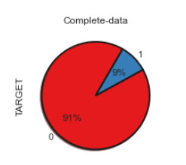
Plot of percentage of fraud vs. non-fraud
We can see that only 9% of the customers done fraud with the bank.

Slide 11
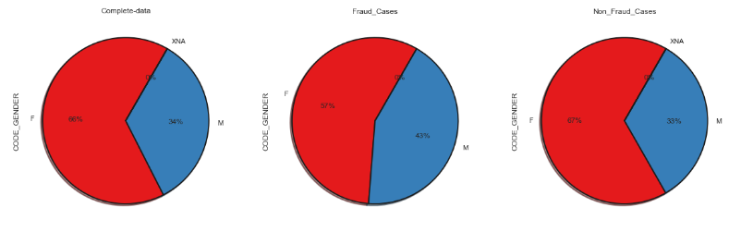
Gender-wise imbalance of fraud vs. non-fraud
Evident from the above that females are more likely to be defaulters

Slide 12
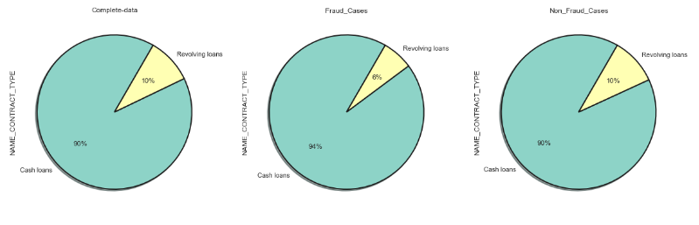
Is there any relationship between cash loans and
revolving loans in terms of defaulters and non-defaulters ?
Cash loans are more popular
Cash loans are more likely to be defaulted

Slide 13
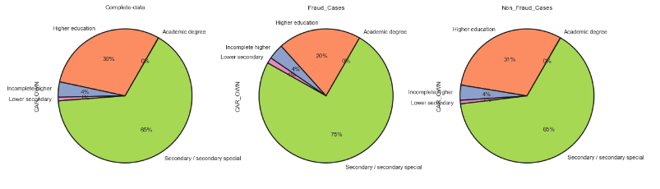
Is there relationship of car owner’s education as defaulters ?
Higher the education lesser the chances of default

Slide 14
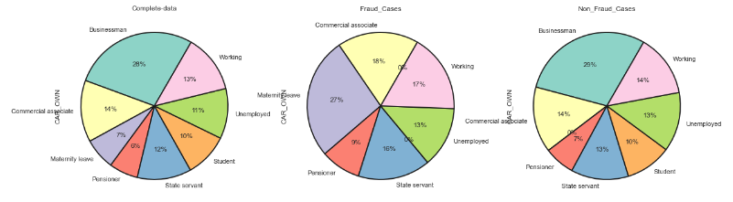
Is there relationship of car owner’s income type as defaulters ?
Car owners who are on maternity leave are more likely to default

Slide 15
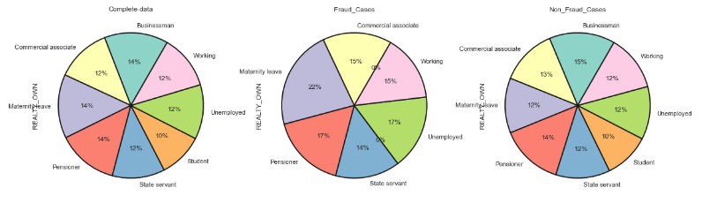
Is there relationship of house owners’ and income type as defaulters ?
House owners who are on maternity leave are more likely to default

Slide 16
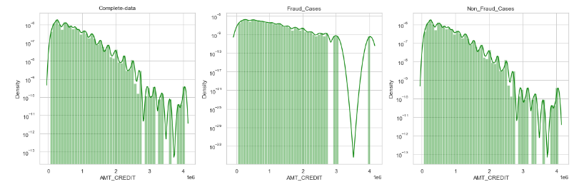
Is there an relationship between amount borrowed and defaulters ?
Considering the loan amount, bank reduces its risk of offering lesser loan amount.
People with higher loans are more likely to default

Slide 17
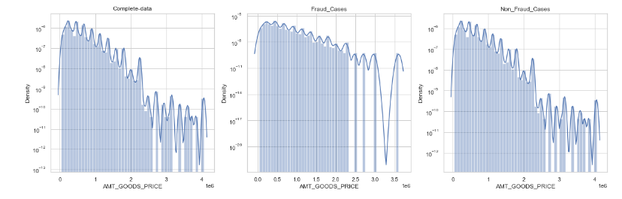
Comparing the AMT_GOODS_PRICE in all the 3 cases - Fraud, Non-Fraud and Complete dataset
Higher money range is declining in all the cases

Slide 18
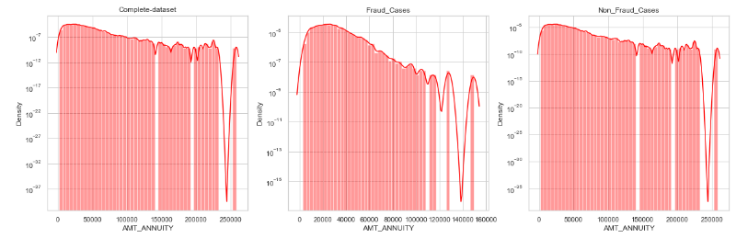
Relationship between loan value and tenure of annuity
There are high volume of Loans with Lesser Annuity

Slide 19
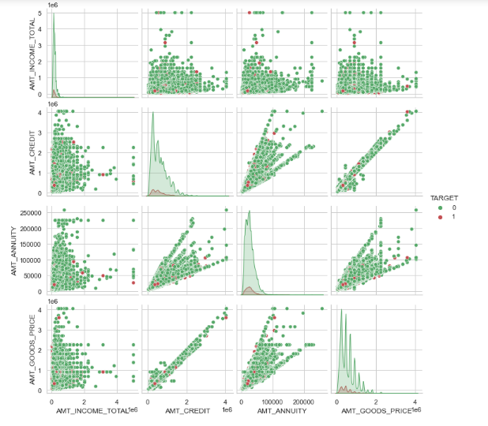
Correlation of all the amounts
There are some highly correlated, like AMT CREDIT and AMT_ANNUITY / AMT_CREDIT and AMT_GOODS_PRICE
Comparatively lesser correlation between AMT_INCOME_TOTAL and AMT_CREDIT

Slide 20
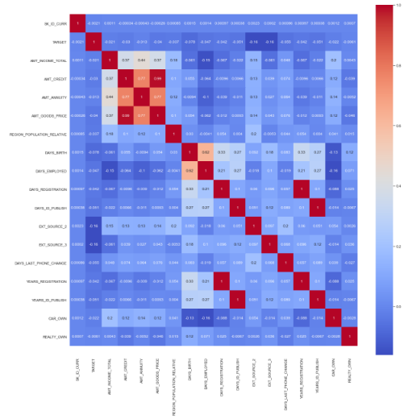
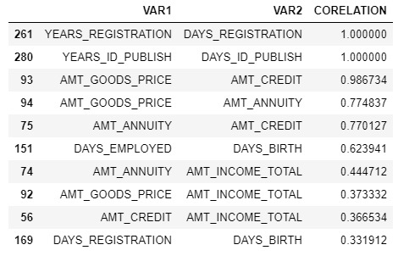
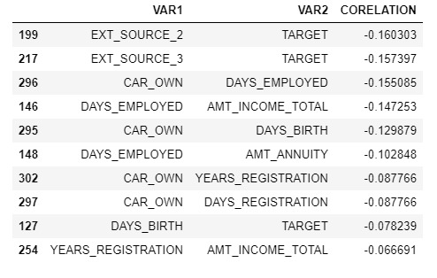
Top 10 co-relationship from heat map of total_bank_data
Positive co-relation
Negative co-relation

Slide 21
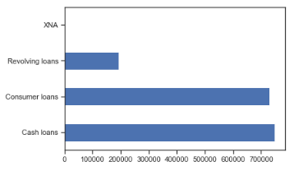
Inferring Types of Loans
Cash loans & consumer loans are more popular than any other loans

Slide 22
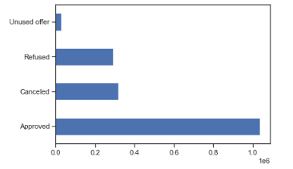
Pattern of NAME_CONTRACT_STATUS
Maximum number of loans that have been approved

Slide 23
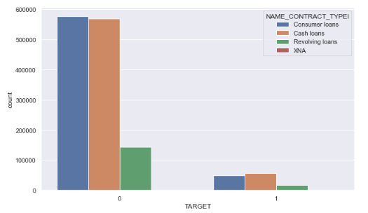
Checking defaulters vs. non-defaulters
Non-defaulters are skewed towards Cash & Consumer loans
Number of defaulters are very less as compared to non-defaulters

Slide 24
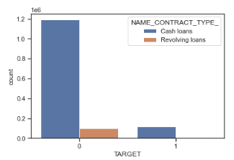
Both defaulters and non-defaulters are skewed towards
Cash loans

Slide 25
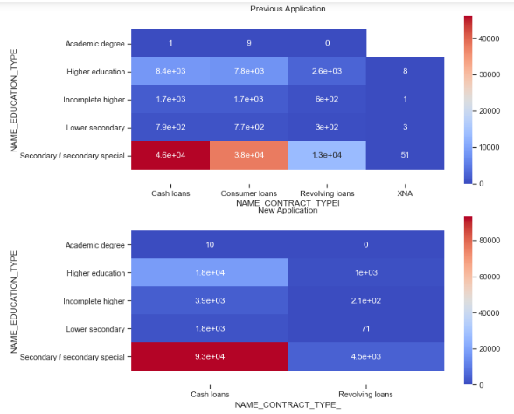
Heat Map of NAME_CONTRACT_TYPE from
Previous data to Application data
You can see kind of same correlation for both the heatmaps where
Secondary education is highly corelated to Cash Loans

Slide 26
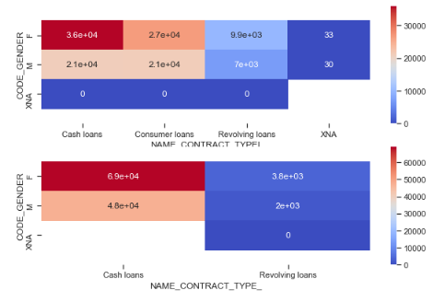
Heatmap of CODE_GENDER and NAME_CONTRACT_TYPE_
with Target as Values,
CODE_GENDER and NAME_CONTRACT_TYPEI with Target as Values
NAME_CONTRACT_TYPE defers from Previous data to Application data
You can see kind of same correlation for both the heatmaps where Female
is highly corelated to Cash Loans

Slide 27
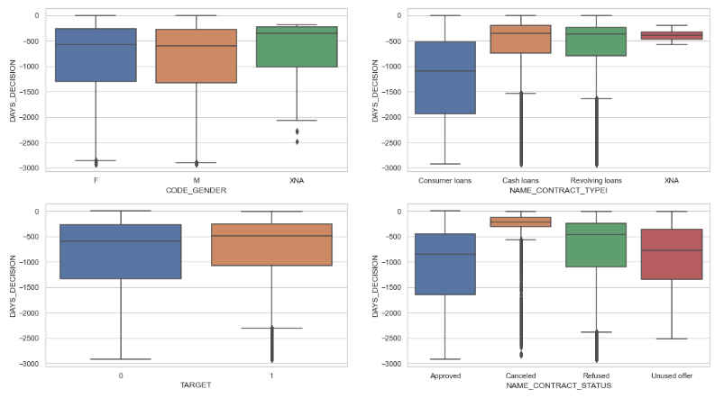
How DAYS_DECISION defers for various categorical attributes ?
You will find Loan cancellation is fastest

Slide 28
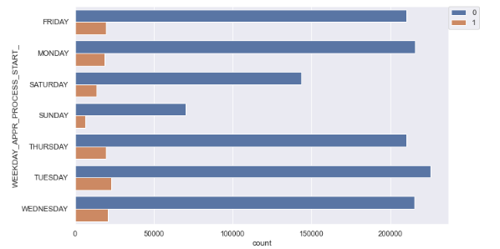
Does days of Application Process start impact on Defaulting ?
There is no significant evidence of days of application process start
impact on defaulting

Slide 29
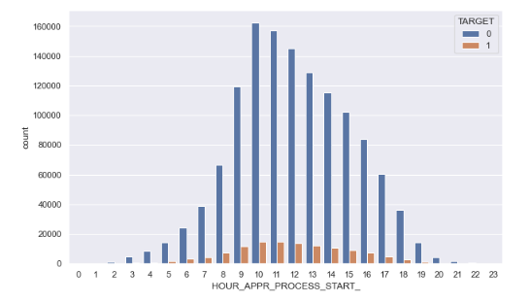
Does days of Application Process start hour impact on Defaulting?
There is no significant evidence as such

Slide 30
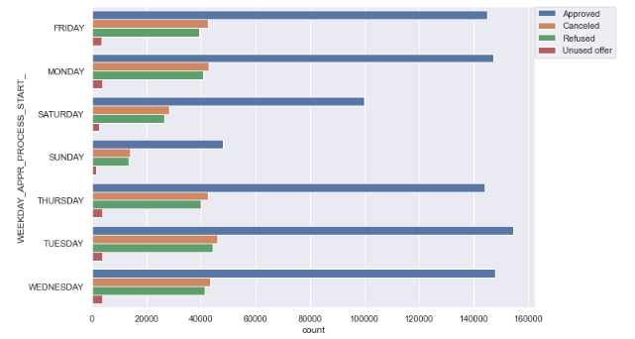
Does days of Application Process start day
impact on Status of the Loans?
Looks like Saturday is a good day of getting approval

Slide 31
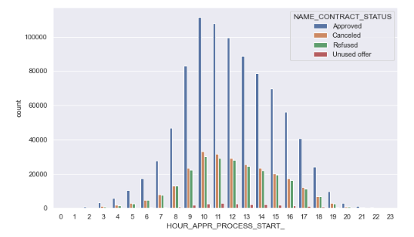
Does days of Application Process start hour impact on
Status of the Loans approval ?
No significant evidence

Slide 32
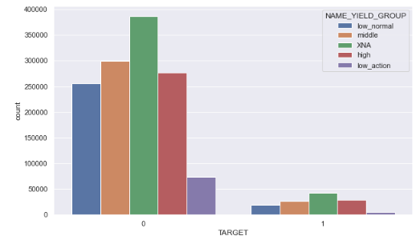
Does Grouped interest rate impact on
Status of defaulting the Loans?
No significant relationship

Slide 33
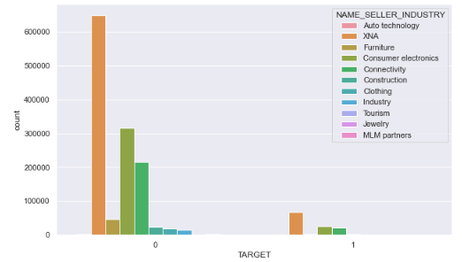
Does Seller Industry impact on
Status of defaulting the Loans?
No significant relationship

Slide 34
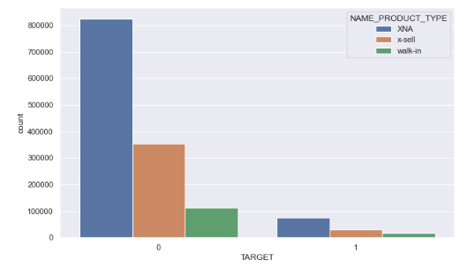
Does Product Type have bearing on Status
of defaulting the Loans?
It is evident that there is no significant relationship

Slide 35
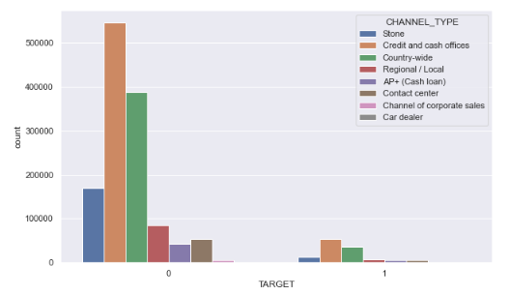
Does loan Channel Type have any bearing on Status of defaulting the Loans?

Slide 36
Summarizing our analysis
Evident from the above that females are more likely to be defaulters. Maternity leave plays a major role
Cash loans are more popular and likely to be defaulted
Higher the education lesser the chances of default
People with higher loans are more likely to default so bank reduces its risk by offering lesser amount
There are high volume of Loans with Lesser Annuity
Longer employment history and longer registration days are less defaulters
It shows a positive correlation between the price of the goods for which the loan is given to amount of annuity.
Higher age people are less likely to default

Slide 37
Thank you
Happy to address should you need any clarification

